Slide 1

UE19CS390A – Capstone Project Phase – 1
Project Progress Review #2
(Project Requirements Specification and Literature Survey)
Project Title : Computer Vision Based Workout Application
Project ID : PW22_SS_01
Project Guide : Prof. Savitri S.
Project Team : Vishnu J G(PES1UG19CS574)
Tejas D R(PES1UG19CS537)
Srujan. A. S(PES1UG19CS509)
PRADEEP V(PES1UG19CS330)

Slide 2
Abstract and Scope
Our project focus is on building a convinient, user friendly and self contained workout application which is based on computer vision.
The application will be able to guide the user during his/her workout sessions and correct postures where applicable.
We wish to implement hands free control of this application, by this the user can control the whole application without having to come out of their workout and use mouse or keyboard.
Having been able to identify the poses and errors in posture of the user during the exercise we may be able to give voice feedbacks to help the user correct his/her posture.

Slide 3
Suggestions from Review – 1
Previously we faced the dilema of wheather or not to implement the side faced exercises, but our pannel members gave us clear instructions to stick to only front faced exercise implementation.
The plan of implementing a centralized workout application was also cut short, as the pannel wanted us to implement a localised workout application and not include the complexity of cloud.
Since these changes have brought around a major boast in our project progress. Initial implementation of mapping of the front faced image to skeletal structure has taken shape.
Hands and fingers recognition and tracking has been implemented but the mapping gestures to functions is yet to be implemented.
Paper review which was initially focused on side as well as front implementation has now been brought down to front faced posture recognition only.

Slide 4
Constraints / Dependencies / Assumptions / Risks
For smoother execution of the application, intense CPU/GPU useage is necessary. This is required as the application has to give real time results. Also, since it is just a single user localized application, only one application per user is applicable.
Our assumption is that all the exercise that we are focusing on are such that the user always faces the camera, so no side view is analysed.
One major obstacle that maybe posed to use in the later stage of the implementation is that we need to be able to integrate our backend and frontend, but since this is infesible, we have to think in the integration perspective right from the initial stage of the backend implementation.

Slide 5
Functional Requirements
The application uses the user’s webcam to capture the workout video and give results in real time.
The workout sequences are matched with the pre-set conditions and if matched, either a count is given or a “correct posture” is displayed.
In case of incorrect posture, a voice guide which corrects the posture is called.
Before or while doing the exercise the user can control the application through gesture control, i.e., users can select, pause and play exercises.

Slide 6
Non - Functional Requirements
Non-functional requirement include having good processing power so that real time results are displayed for the user.
The camera should be able to give clear pictures, such that contours of the user from the video frames can be obtained.
Since no images or videos are saved or stored for further processing, not much storage space is required.

Slide 7
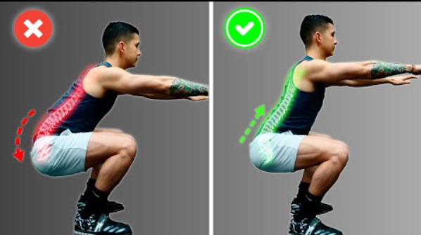
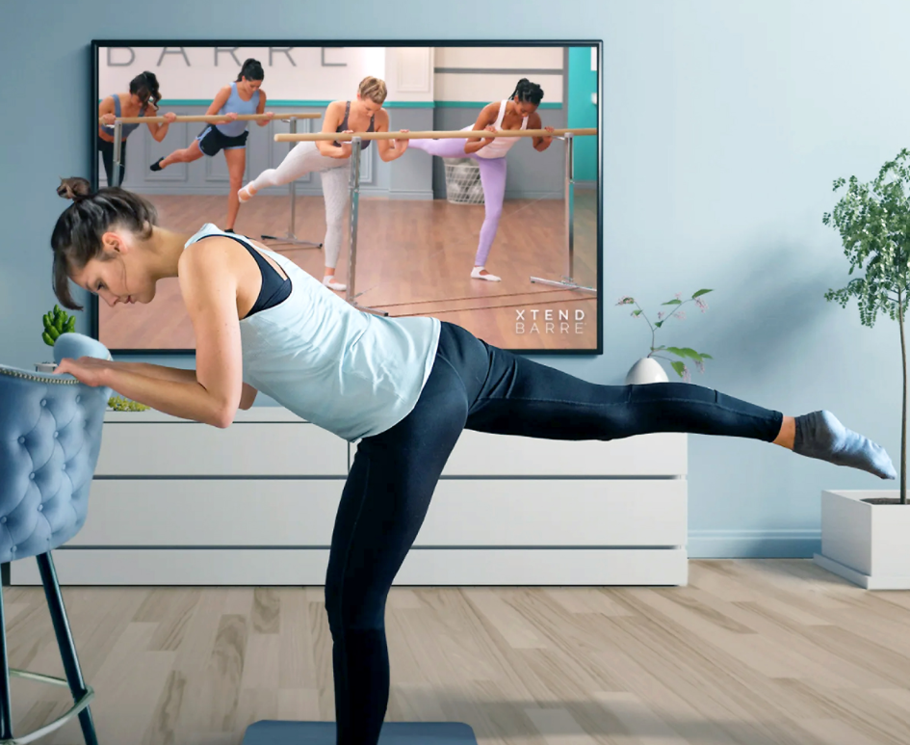
Paper 1 - Literature Survey of Realtime Indoor Workout Analysis Using Machine Learning and Computer Vision
This research is focused on assisting people to workout independently on their own. The assistance is in the form of correcting the posture of the body for people who find it difficult to follow the accurate postures when they visit gyms.
The argument put forward is that incorrect postures during exercise cause more bad than good to the user.
To solve this problem, visual feedback is given while performing workouts.
In this model the user’s postures are recorded and compared with a pre recorded professional’s video.
The system is build on deep learning for human pose detection.

Slide 8
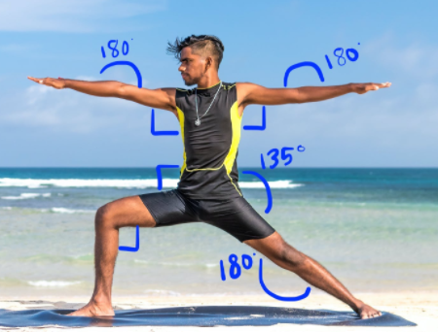
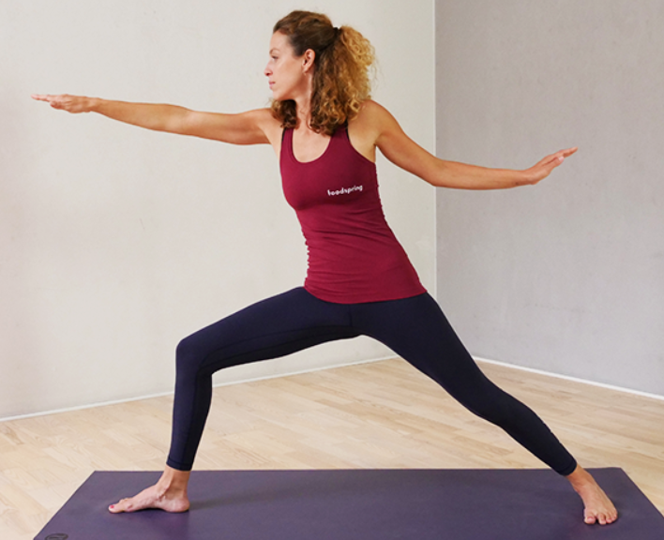
Reference Video
1 - Literature Survey
Pre-Process
Time series data alignment techniques like Dynamic Time Wraping(DTW) and optical flow tracking are used to synchronize user and reference videos.
Errors in user’s poses are detected with some threshold deviation between the limb angles.
The model requires a professional to record the workout video and then this video is pre-processed before the user’s video which is captured can be and compared with this reference video.
Since the requirement is only with specific frames of the reference video, a high frame rate video is broken down such that only a few frames at fixed time instances are considered for analysis.
Model
User’s Video

Slide 9
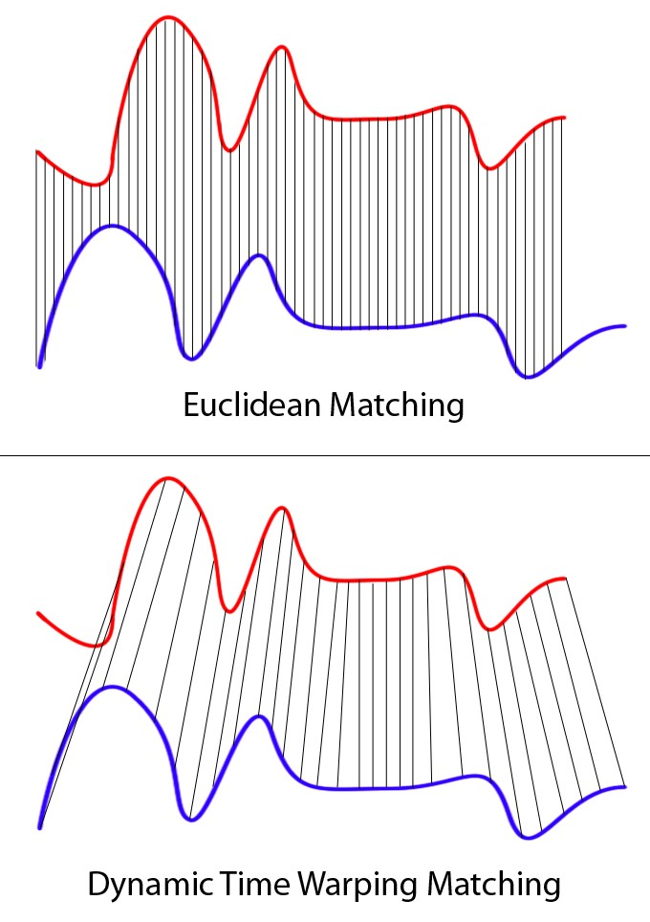
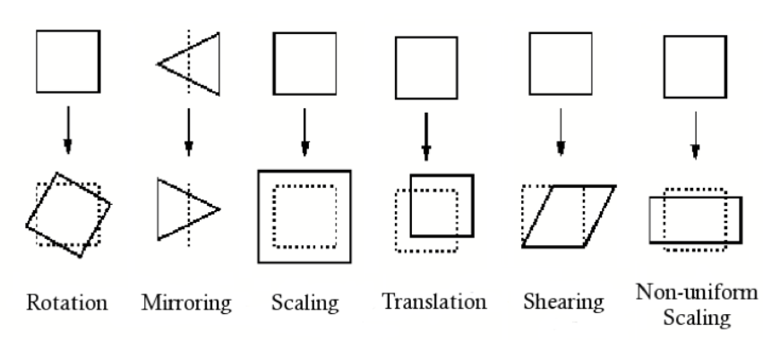
1 - Literature Survey
The number of frames to choose is based on a pre set threshold, if a frame falls at a time difference lower than the previous selected frame, then this frame is ignored else it is selected as the next frame.
The closest matching frames between the referenced video and the user’s video is found using the DTW algorithm.
A critical step in this paper includes affine transformation, since matching of frames is done, we need to take care of referenced and user’s body ratio, tilts in the camera and person to camera distance. This is done by basic matrix transformation AX=Y.

Slide 10
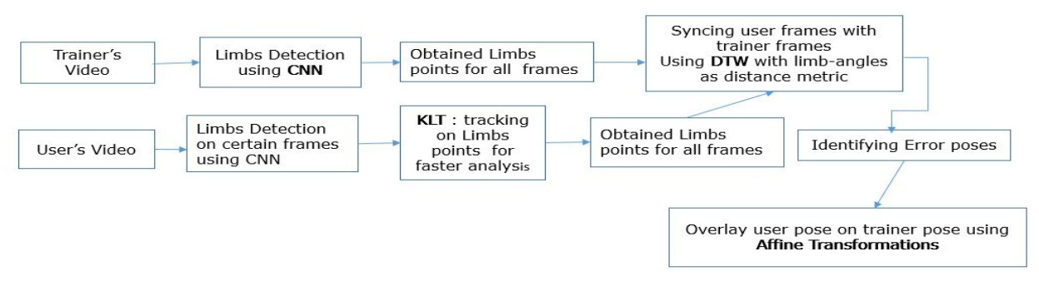
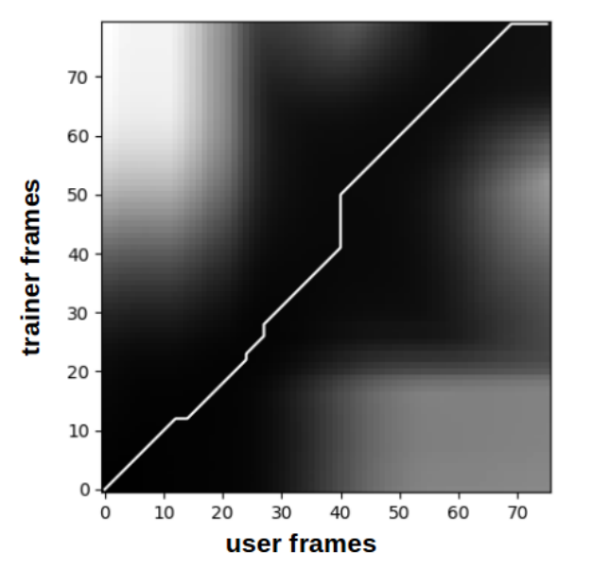
1 - Literature Survey
The image above shows the basic flow of the application.
The graph shows how frames are matched, hortizontal lines shows that many user’s frames have mapped to the same reference frame(which is a problem needed to be additionally handled)
In the graph we can also observe vertical lines which shows how a single frame of the user has been mapped to multiple reference frames(which is a bigger drawback)

Slide 11
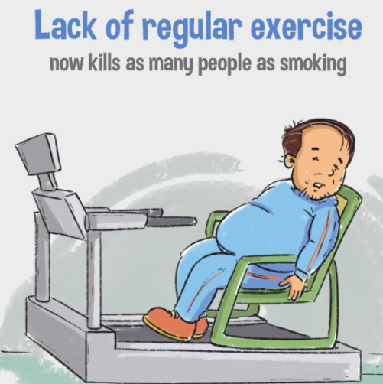
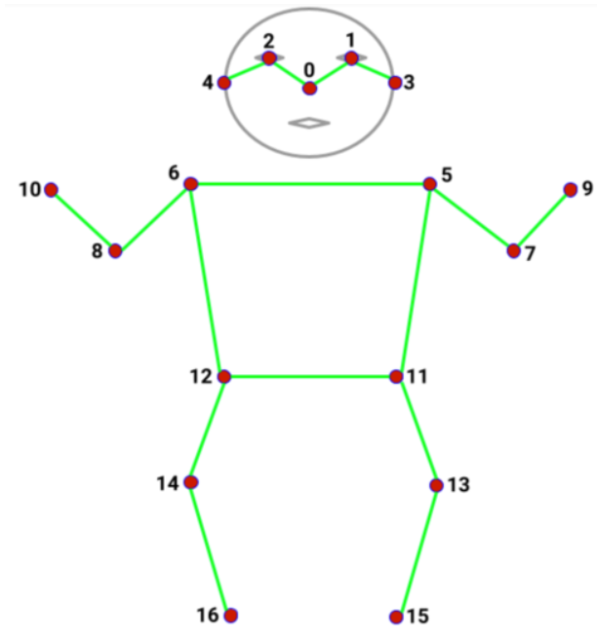
Paper 2 - Literature Survey Workout tracking using Pose-Estimation and DNN
Main focus in this paper is to reduce deaths due to lack of fitness.
Auto_fit uses Postnet for doing pose estimation to find 17 body keypoints followed by using the DNN classifier to identify the state of exercise and then counts the repetitions performed.
Auto_fit takes live video feed and counts the repetitions of exercise performed. It works on two common exercises.
In the first part, it creates the skeleton of the user with 17 points like wrist, knees, ankles, etc. these points are identified using TensorFlow Postnet model which uses Mobilenet_V1 under the hood.

Slide 12
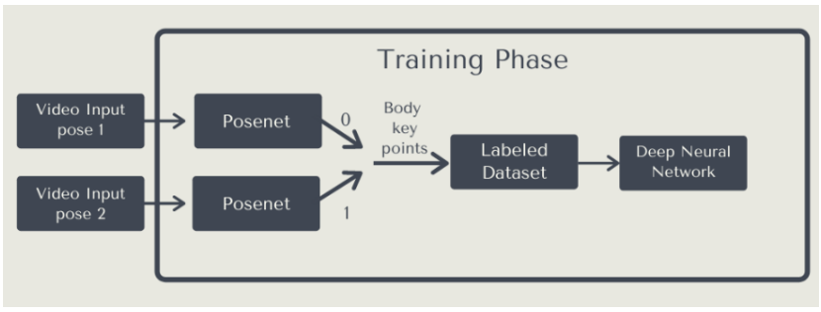
2 - Literature Survey
The identified points are then passed to a deep neural network model which is trained to identify the correct pose and count the repetitions of an exercise through live camera feed.
Nevertheless, such procedures typically bank on estimating the skeleton of the user, this technique can be undependable when users are at a greater distance from the cameras and there is substantial occlusion, this scenario is very likely to happen at the gym.
In this phase first, the exercise is taken and divide it into initial and final states. Then video is divded into two parts and labeled as initial and final states. Then both the videos are feed into the posenet model which generates the coordinates of body key points for corresponding videos. Then those coordinates are combined into a single dataset and are given as input to the DNN classifier for training. As shown in the figure above.

Slide 13
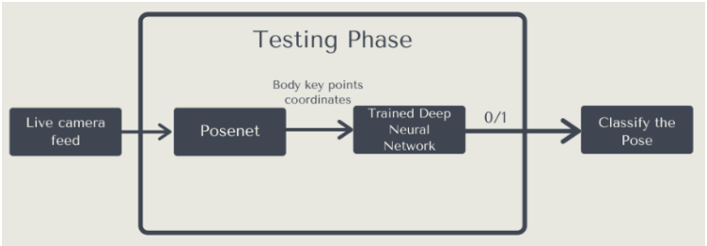
2 - Literature Survey
For testing, the video stream is taken live from the camera and fed into the posenet model which generates the coordinates of body key-points in that frame.
Those keypoint coordinates are then fed into the DNN classifier which was trained in the first phase. The DNN classifier identifies the pose as the initial or final state of the exercise.

Slide 14
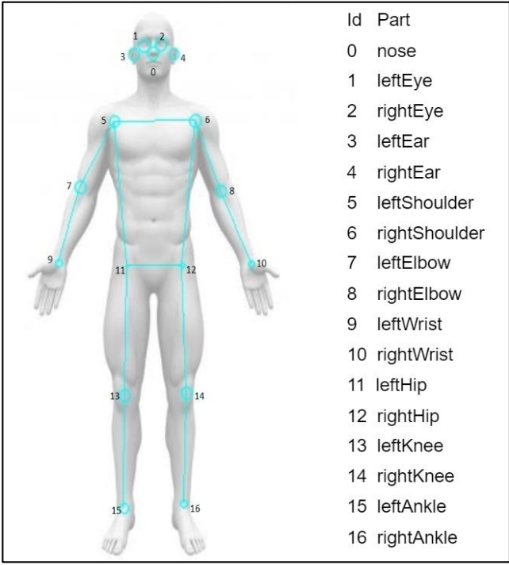
2 - Literature Survey
For pose estimation, deep convolutional neural networks (CNNs) are used to form pose coordinates.
PoseNet is a vision model that is used to estimate the pose of a person in an image or video by estimating where key body joints are.
The PoseNet model is image size invariant, which means it can predict pose positions on the same scale as the original image regardless of whether the image is downscaled.
This is a plus point as compared to the previous paper where we had to manually correct the size ratio.

Slide 15
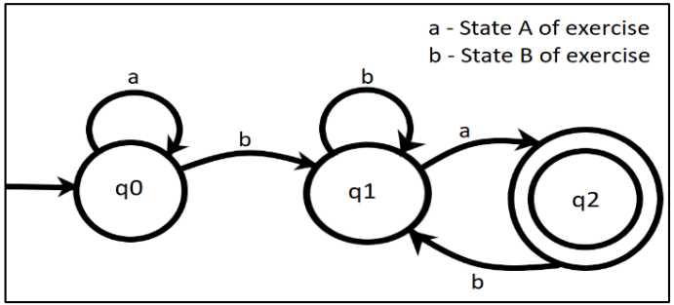
2 - Literature Survey
Binary-Cross Entropy is used as a loss function and RMSprop as an optimizer.
DNN consists of 4 layers. In the first layer, there are 128 neurons and then there are 2 hidden layers with 64 and 32 neurons respectively and the output layer has 1 neuron which gives 0,1 as result here relu is used as the activation function.
This model can only identify 2 stages, intital and final which is used as count for repetions performed.

Slide 16
Paper 3 - Literature Survey on Robust Hand Gesture Recognition Algorithm for Simple Mouse Control
This paper mainly focuses on the principle of touch free control of the application or device, which helps the user to control their device from far, by not actually using hardware to navigate.
This is very useful for a person who is doing workout and wants to control the application to navigate to certain posture from his position.
In this paper they have used hand gesture recognition algorithm for performing this task.
The process of the gesture recognition can be divided into two separate problems 1) Segmentation of hands 2) Noise removal 3) Recognition.

Slide 17
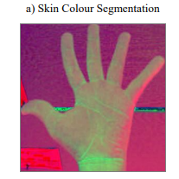
3 - Literature Survey
Hand Detection
Assuming that the hand is the major portion in the image, it would be easy to segment it by using the segmentation techniques.
This classical method for segmenting the skin pixels sets upper and lower bound values using which the hand is segmented.
The images are resized to a fixed resolution before performing the recognition process, usually to the resolution of the camera used.

Slide 18
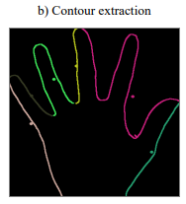
3 - Literature Survey
B. Noise Removal
It classifies noisy objects as skin; therefore noise removal of the segmented image is absolutely necessary.
An image morphology algorithm which uses CNN to perform image erosion and image dilation to eliminate noise is used.
Erosion trims down the image area where the hand is not present and Dilation expands the area of the Image pixels which are not eroded.
In this paper, they performed erode function with a structure of 8 x 8 square element three times and dilate function with a structure of 6 x 6 square element three times. Most of the noise was removed.

Slide 19
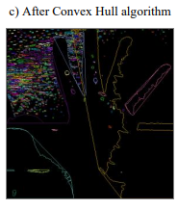
3 - Literature Survey
C. Gesture Recognition
The centre coordinate of the hand would be calculated, then the size of the hand would then be determined by drawing a circle increasing the radius of the circle from its centre coordinate.
Now in order to recognize the finger tips they have used the convex hull algorithm. The convex hull algorithm is used to solve the problem of finding the biggest polygon including all vertices.
The distance between the center and a pixel which is in convex hull set is calculated and if the distance is longer than the radius of the hand, then a finger is spread.
Similarly using this approach the gestures are identified and recognized an certain thresholds are set in order to reject the invalid results.

Slide 20
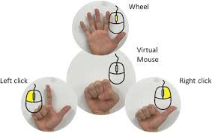
3 - Literature Survey
Using the above gesture recognition technique, they had implemented a small program for performing simple mouse actions. The actions performed were
left click
right click
double clicking
scrolling

Slide 21
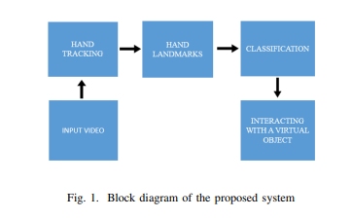
Paper 4 - Literature Survey on Development of a Learning-aid tool using Hand Gesture Based Human Computer Interaction System
This paper mainly focuses on interactive learning-aid tool based on a vision-based hand gesture recognition system.
The system uses MediaPipe for hand gesture recognition. The recognized hand gestures use a virtual-mouse-based object controlling system to control various virtual objects created using Unity.
Kinetic user interfaces (KUI) are a new type of user interface that lets users interact with computers by moving their bodies and things around. A touchless user interface (TUI) is a new type of technology for gesture control.
MediaPipe’s opensource framework and machine learning algorithm, presented a way for simplifying Sign Language recognition. The prediction model is simple to use and adaptable to different types of smart devices.

Slide 22
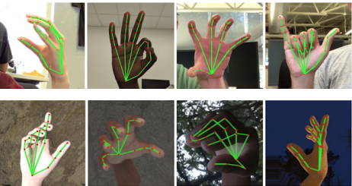
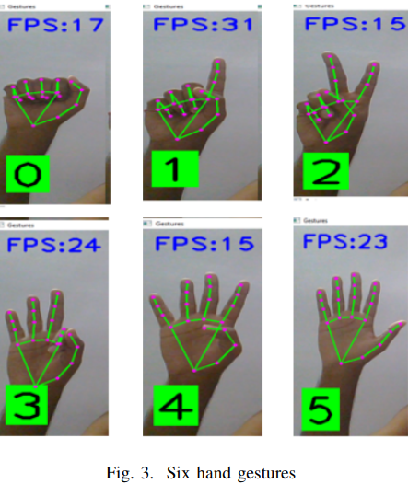
4 - Literature Survey
Hand tracking by mediapipe
Hand tracking steps are:
Realtime Hand Detection: First, instead of training a hand detector, we train a palm detector because estimating bounding boxes of inflexible objects like palms and fists is much easier than recognizing hands with articulated fingers.
2) Hand Landmark: Following palm detection over the entire image, our next hand landmark model uses regression to accomplish exact keypoint localization of 21 3D hand-knuckle coordinates within the detected hand regions, i.e. direct coordinate prediction.
3) Gesture Classification: We generate the gestures from the projected hand skeleton. In this paper they have divided gestures into six categories: zero, one, two, three, four, and five as shown in Fig.3.

Slide 23
4 - Literature Survey
B. Mediapipe
Google’s Mediapipe is a cross-platform library that delivers great ready-to-use machine learning solutions for computer vision workloads.
MediaPipe is a structure that allows developers to create cross-platform multimodal (video, audio, and any time series data) applied machine learning pipelines.
Human body detection and tracking models from MediaPipe have been trained using Google’s enormous and diverse dataset. They track critical spots on different regions of the body as a skeleton of nodes, edges, and landmarks.
Three dimension normalization is applied to all coordinate points. The flow of information is easily adaptable and adjustable via graphs. The training and classification of hand gestures is done using MediaPipe.

Slide 24
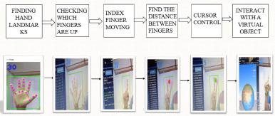
4 - Literature Survey
C. Human Computer Interaction
The block diagram of the human computer interaction (HCI) is shown
D. Unity3D
Unity is the most popular platform for developing and managing real-time 3D content in the world. Unity3D is used to create virtual objects and these virtual objects are manipulated use hand gestures.

Slide 25
5 - Literature Survey
This paper mainly focuses on how to use computer operations through hand gestures and movements, which is one of the most efficient methods to utilize a computer.
This way of controlling laptops and computers using hand gestures is known as leap motion.

Slide 26
5 - Literature Survey
Mouse movement: Moving the pointer hand allows you to move the mouse around. The mouse cursor coordinates on the computer's desktop are transferred to the centroid of the pointer hand's coordinates inside the processed picture.
Activating and deactivating mouse control: Activating and deactivating the mouse's interpretation of gesture-based commands is essential in various situations. Making a gesture with both hands, each of which has five extended fingers, accomplishes this.

Slide 27
5 - Literature Survey
The main steps involved are :
The movements done by the user will be then recognized using open CV. (OpenCV is a large open-source library for image processing, computer vision, and machine learning.)
This will be followed by the mapping of the movements of the hand to a co-ordinate already specified.
This mapping will be then analysed to corresponding cursor movements. These movements will help to recognize and analyse the gestures.

Slide 28
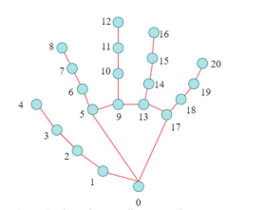
5 - Literature Survey
Hand tracking is combined with fingertip detection which makes it easy to develop simple, reliable hand gesture languages that may be used by a human operator to send control information to a computer system.
The above figure describes Fingertips coordinate mapping, fingertips are numbered from 0 to 20, with each fingertip receiving its own number. (Mediapipe, Pynput & OpenCV are the libraries and packages are used for this.)

Slide 29
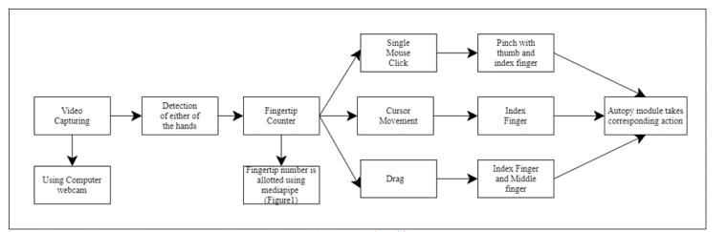
5 - Literature Survey
The above figure is the conceptual architecture.

Slide 30
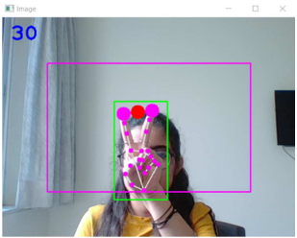
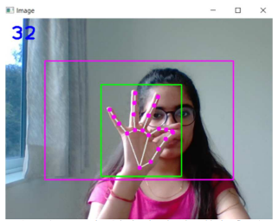
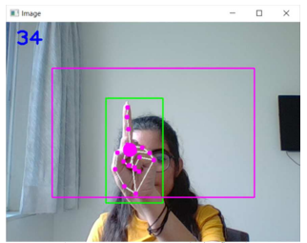
5 - Literature Survey
1. Single click action (index finger and middle finger)
2. Drag Action (Pinch using thumb and index finger)
3. Mouse Movement (Index finger)

Slide 31
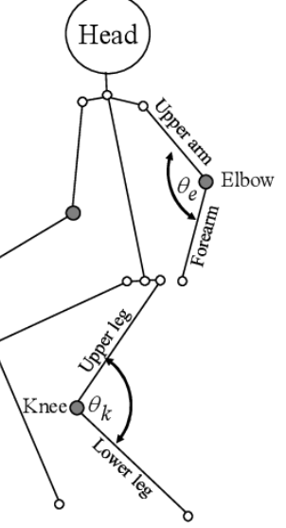
Summary of Literature Survey
The initial 2 research papers talk about comparison of frames of the user and a referential video frames. In the 1st paper DWT algorithm is used to map same frames of user and guide. This is a huge overhead(mentioned in the paper).
In the 2nd paper the user’s initial and final poses are only considered and all other intermediate poses are ignored. But again before ignoring the user’s frames are compared to is if the user is in the initial stage or the final stage or any intermediate stage. Although PoseNet is used which overcomes the problem of affine transformations, the limitation of only 2 stages of exercise is a drawback to the objective of the project.
We propose to gather info from references and create a logic such that only angles and inclination in the user’s video frames are checked instead of comparing and report results.

Slide 32
Conclusion
We conclude this phase of literature survey that implementation up until now pertains to comparison of user and reference video which creates a huge latency, to overcome this, instead of comparing frames we propose to compare angles and inclinations only.
Also some implementation with PoseNet have been depricated and so we are planning to go ahead with MediaPipe.
Hand gesture based control is another add on in our application, we propose to overlap 2 mediapipe identification models(one for the pose and one for hand gesture).
This way we need not take 2 copies of the same frame or store the frames to control the app or carry out exercises.

Slide 33
References
1. A. Nagarkoti, R. Teotia, A. K. Mahale and P. K. Das, "Realtime Indoor Workout Analysis Using Machine Learning & Computer Vision," 2019 41st Annual International Conference of the IEEE Engineering in Medicine and Biology Society (EMBC), 2019, pp. 1440-1443, doi: 10.1109/EMBC.2019.8856547.
2. Nitesh Sonwani, Aryan Pegwar, “Auto_Fit: WORKOUT TRACKING USING POSE-ESTIMATION AND DNN”, International Journal of Engineering Applied Sciences and Technology, 2020 Vol. 5, Issue 1, ISSN No. 2455-2143, Pages 167-173 Published Online May 2020 in IJEAST, doi: 10.33564/IJEAST.2020.v05i01.024
3.

Slide 34
Thank You

